Slide 1
Gado Jalandoni Scholarships

Slide 2
Client Background

Slide 3
Pain Points

Slide 4
Iterations

Slide 5
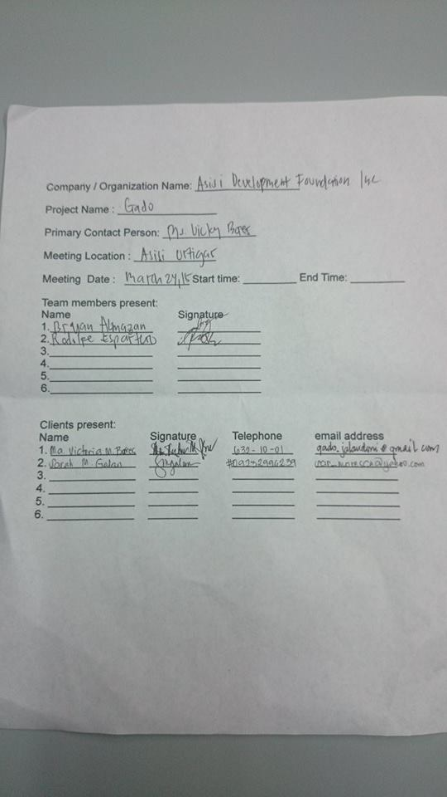

Slide 6
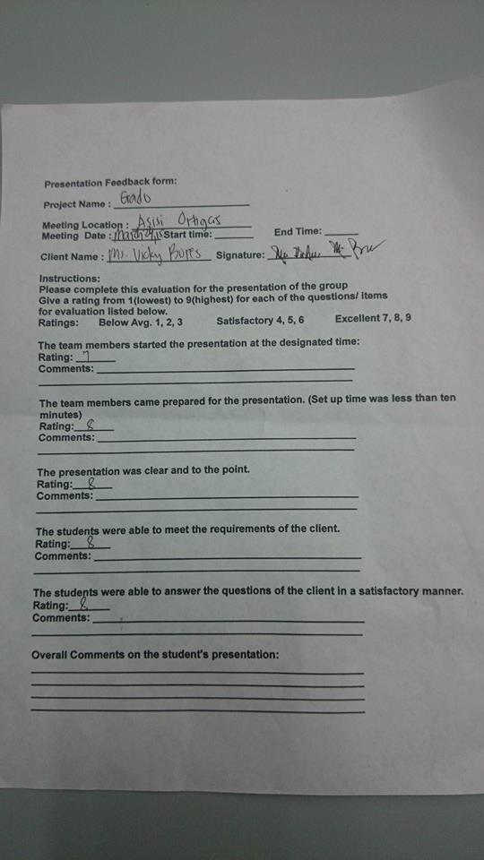

Slide 7
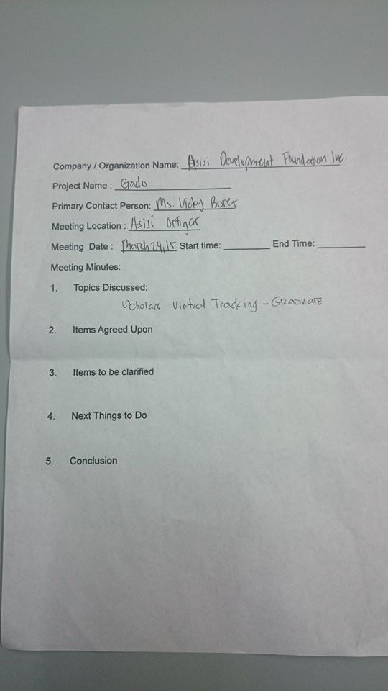

Slide 8
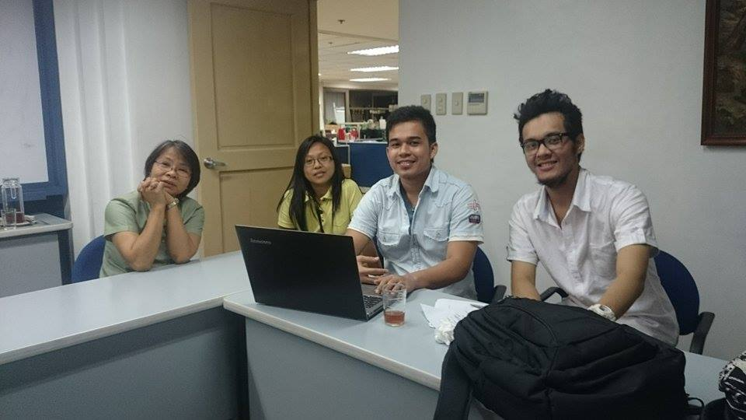

Slide 9
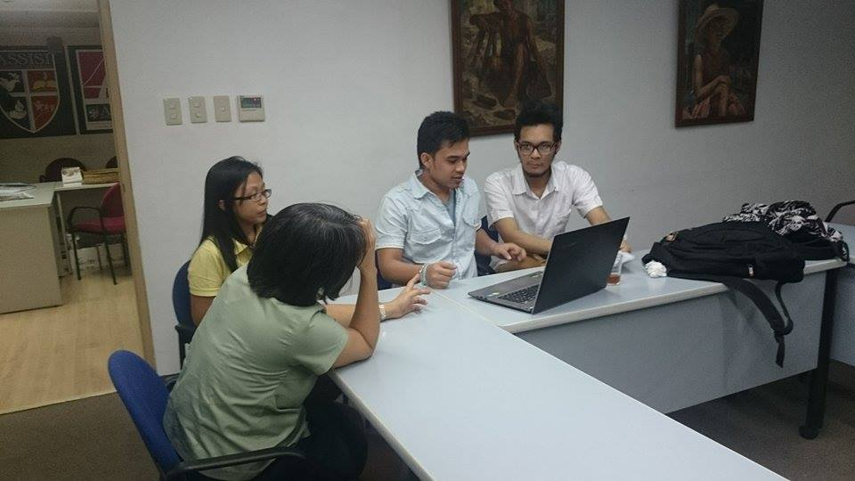

Slide 10
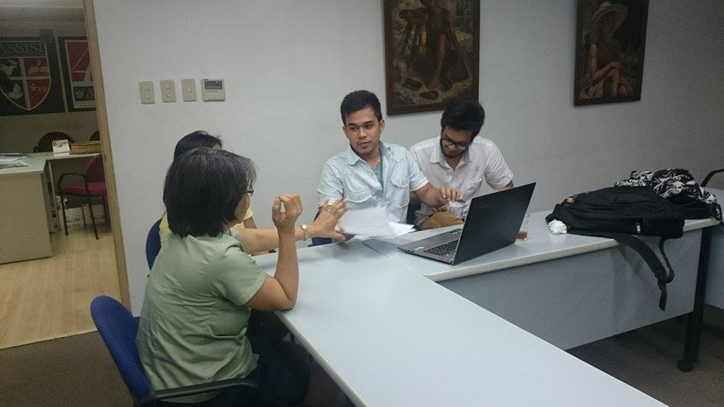

Slide 11
Contributions

Slide 12
Demo

Slide 13
Current Status

